Slide 1
Electronic Devices
Mid Term Lecture - 05
Faculty Name: Dr. Md. Kabiruzzaman
Email : kabiruzzaman@aiub.edu
Reference book:
Electronic Devices and Circuit Theory (Chapter-2)
Robert L. Boylestad and L. Nashelsky , (11th Edition)

Slide 2
Objectives
Be able to predict the output response of a clipper and clamper diode configuration.

Slide 3
CLIPPERS
Clippers are networks that employ diodes to “clip” away a portion of an input signal without distorting the remaining part of the applied waveform.
The half-wave rectifier is an example of the simplest form of diode clipper- one resistor and a diode. Depending on the orientation of the diode, the positive or negative region of the applied signal is “clipped” off.
There are two general categories of clippers: series and parallel.
The series configuration is defined as one where the diode is in series with the load, whereas the parallel variety has the diode in a branch parallel to the load.

Slide 4
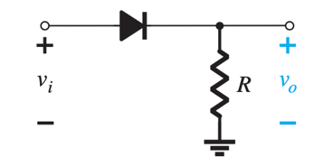
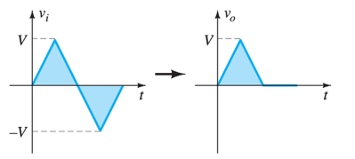
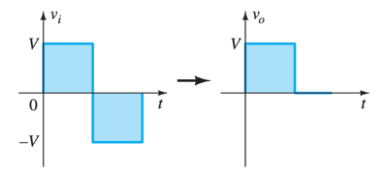
CLIPPERS: SERIES
Diode is in series with the load.

Slide 5
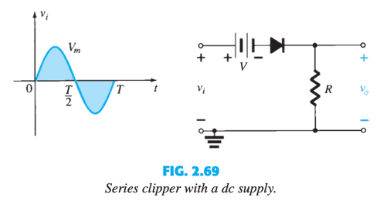
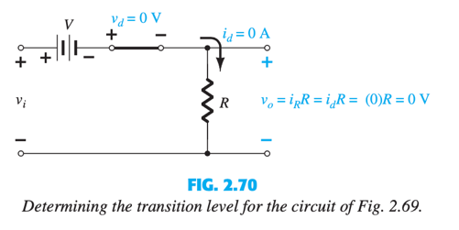
Series Clipper with a dc supply

Slide 6
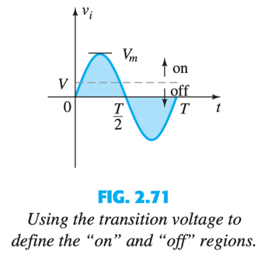
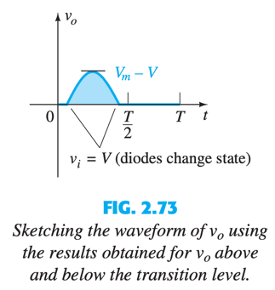
CLIPPERS: SERIES
Use transition voltage to define “on” and “off” regions
Draw the output waveform directly below the applied voltage using the same scales for the horizontal axis and the vertical axis.
Negative half cycle clipped away in output waveform

Slide 7
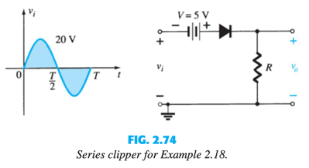

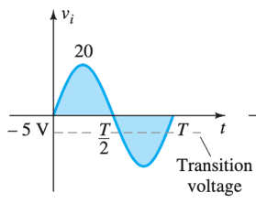
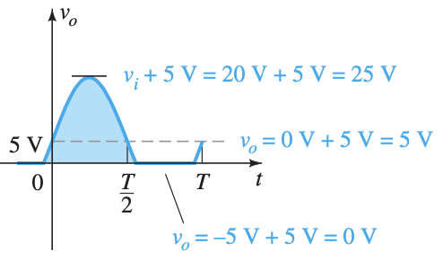

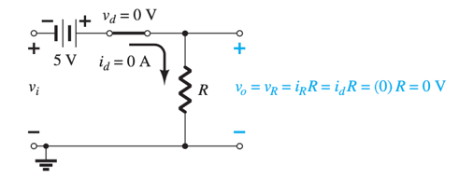
CLIPPERS: SERIES
Determine transition level

Slide 8
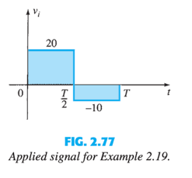
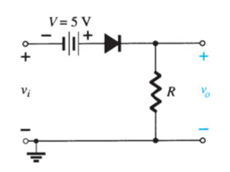
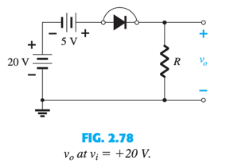
CLIPPERS: SERIES
For v_{i} = 20 V (0 --> T/2) the network results,
The diode is in the short-circuit state.
v_{o} = 20V + 5V = 25V

Slide 9
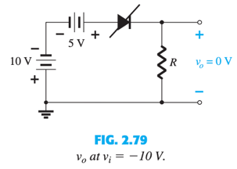
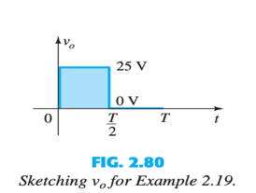
For v_{i} = -10 V (T/2 --> T) the network results,
The diode is in the “off” state.
v_{o} = i_{R}R = (0)R = 0 V
The resulting output voltage corresponds to input voltage appears as:

Slide 10
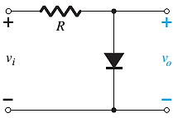
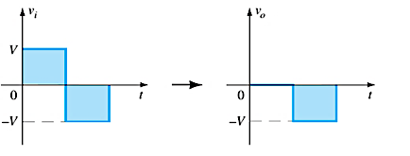
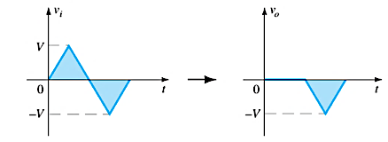
CLIPPERS: PARALLEL
Diode in a branch parallel to the load.

Slide 11
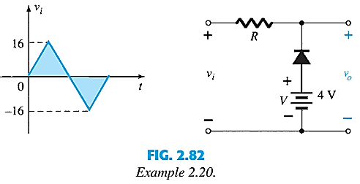
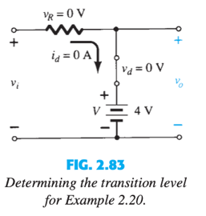

CLIPPERS: PARALLEL
Determine output across the series combination of the diode and the 4-V supply
Determine transition level of input voltage.
Condition:
Replace circuit with short-circuit equivalent.
Diode current is 0 mA.

Slide 12
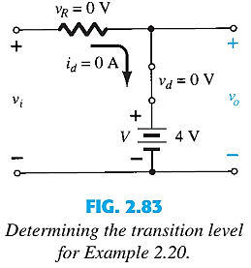
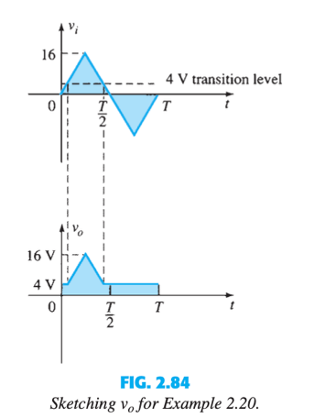
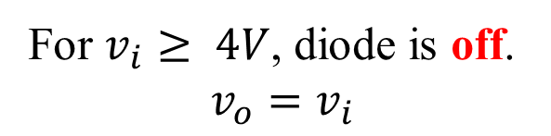
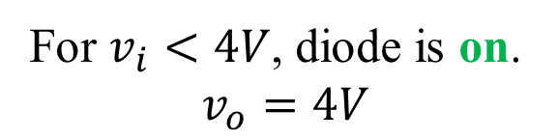
For $v_{i}<4V$, diode is on.
$$v_{o}=4V$$
For $v_{i}≥ 4V$, diode is off.
$$v_{o}=v_{i}$$

Slide 13
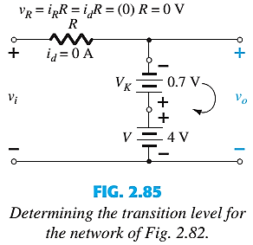

CLIPPERS: PARALLEL
Si
Determine transition level of input voltage.
Condition:
Replace circuit with diode equivalent circuit.
Diode current is 0 mA.
Applying KVL around output loop in clockwise direction,

Slide 14
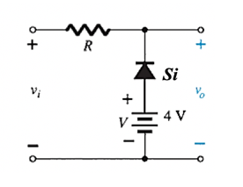
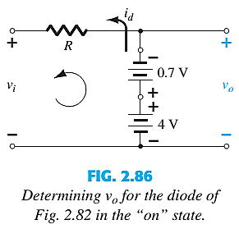
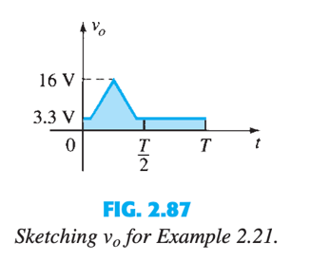
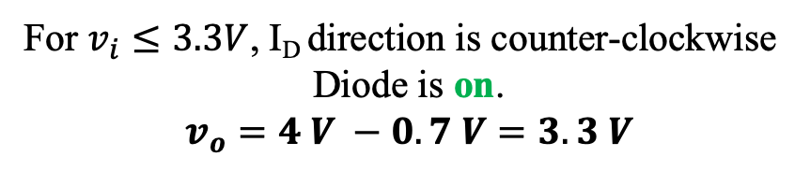
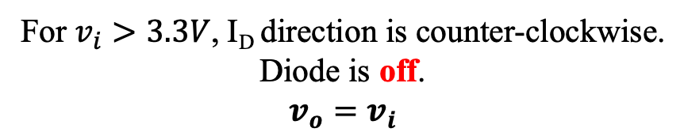
For $v_{i}>3.3V$, I_{D} direction is counter-clockwise.
Diode is off.
$$v_{o}=v_{i}$$
For $v_{i}≤3.3V$, I_{D} direction is counter-clockwise
Diode is on.
$$v_{o}=4 V −0.7 V=3.3 V$$

Slide 15
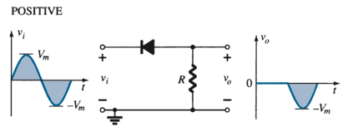
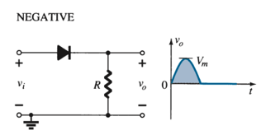
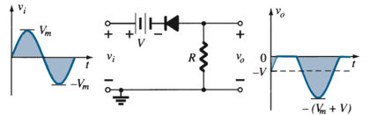
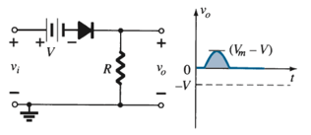
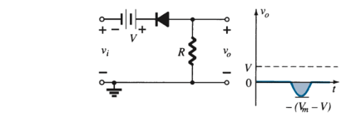
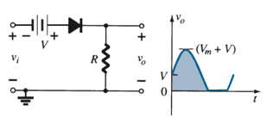
CLIPPERS
Simple Series clippers (Ideal Diodes) for the sinusoidal input
Biased Series Clippers (Ideal Diodes)

Slide 16

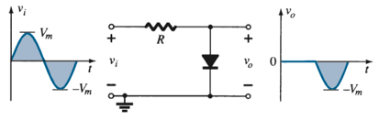
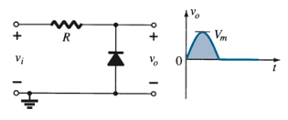
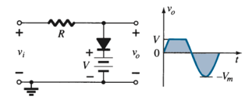
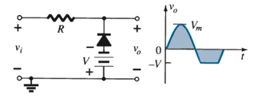
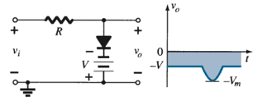
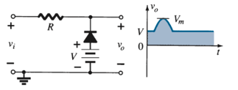
CLIPPERS
Simple Parallel clippers (Ideal Diodes) for the sinusoidal input
Biased Parallel Clippers (Ideal Diodes)

Slide 17
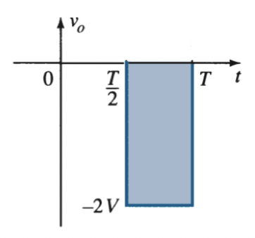
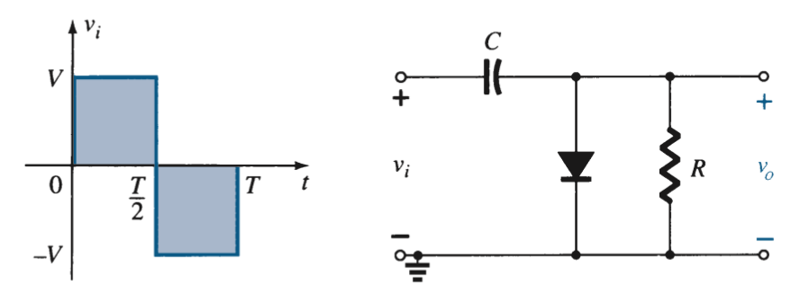
CLAMPERS
A clamper is a network constructed of a diode, a resistor, and a capacitor that shifts a waveform to a different dc level without changing the appearance of the applied signal.
The output signal is clamped to 0 V for the interval 0 to T/2 but maintains the same total swing (2V ) as the input.

Slide 18
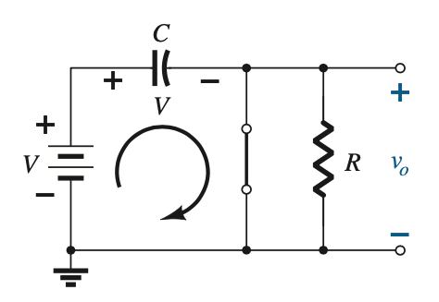
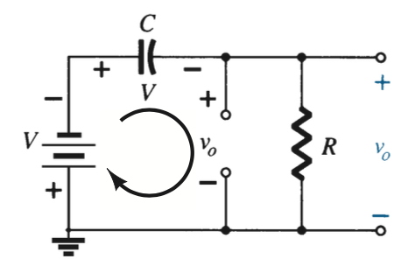
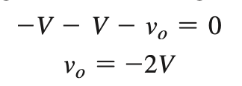

CLAMPERS
Step 1: Start the analysis by examining the response of the portion of the input signal that will forward bias the diode.
Step 2: During the period that the diode is in the “on” state, assume that the capacitor will charge up instantaneously to a voltage level determined by the surrounding network.
Step 3: Assume that during the period when the diode is in the “off” state the capacitor holds on to its established voltage level.
For the interval 0 -> T/2 :
For the interval T/2 -> T :
$$v_{o}=0$$
$$v_{c}=V$$

Slide 19
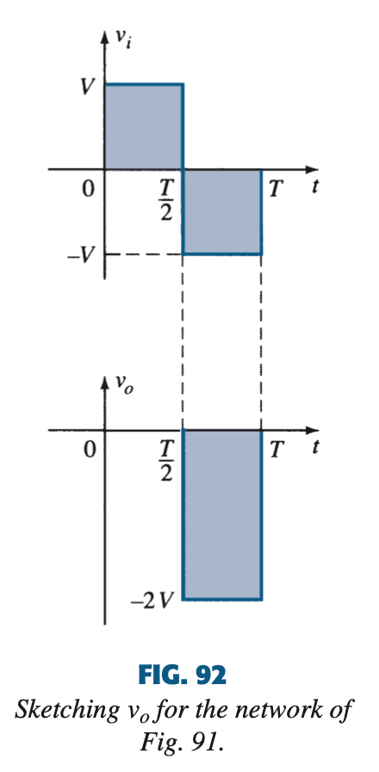
Step 4: Throughout the analysis, maintain a continual awareness of the location and defined polarity for v_{o} to ensure that the proper levels are obtained.
Step 5: Check that the total swing of the output matches that of the input.
The output signal maintains the same total swing (2V) as the input.

Slide 20
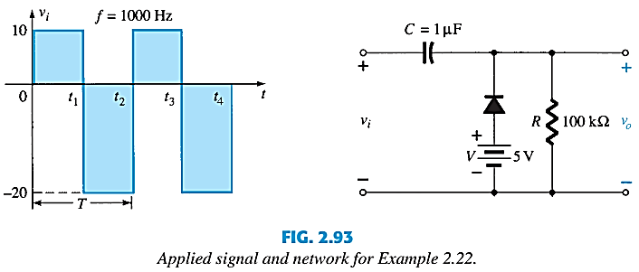



CLAMPERS
From t₁ to t₂ period of the input signal the diode will be forward biased.
$$v_{o}=5 V$$

Slide 21




From t₂ to t₃ period of the input signal the diode will be reverse biased
The output swing of 30 V matches the input swing.
See Example 2.23

Slide 22






Clamping Networks

Slide 23
Thank You

